Slide 1

Interfacing LCD with
ARM7 LPC2148
DAY 14
EMBEDDED SYSTEM DESIGN & IoT-Master Class

Slide 2
What You will learn Today?
Introduction to LCD
Pin details and Descriptions
Schematics
Program

Slide 3
Mindset Lesson for the Day
See Good in People , People see good in you

Slide 4
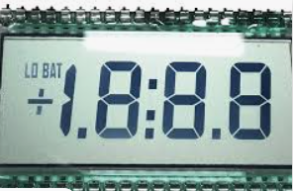
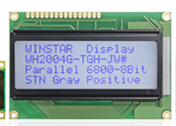
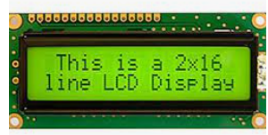
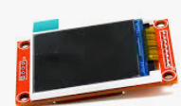
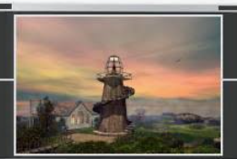
What is LCD
A liquid-crystal display (LCD) is a flat-panel display or other electronically modulated optical device that uses the light-modulating properties of liquid crystals combined with polarizers. Liquid crystals do not emit light directly,[1] instead using a backlight or reflector to produce images in color or monochrome

Slide 5
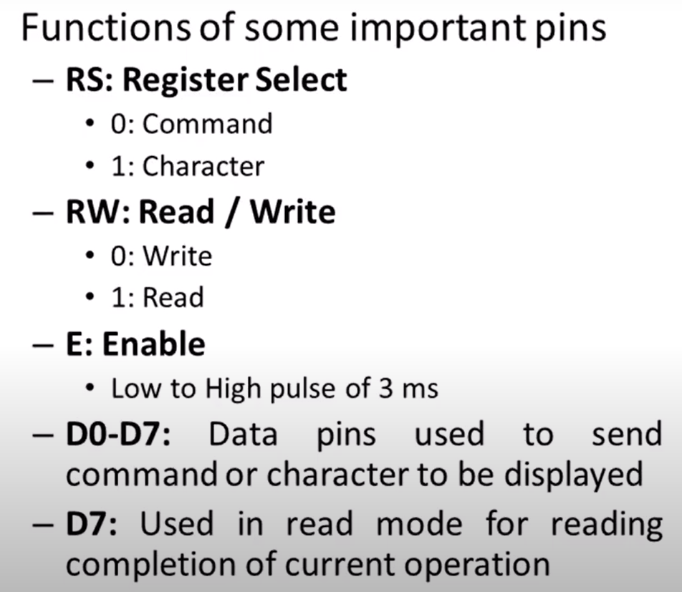
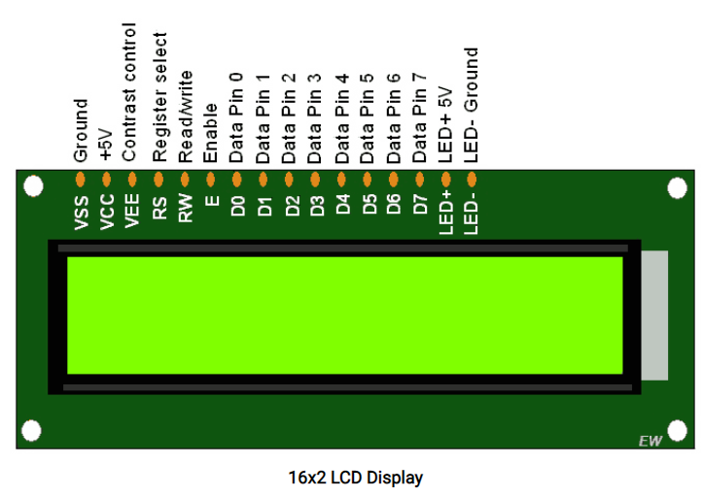
PIN Details of LCD

Slide 6
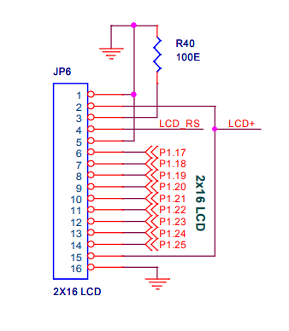
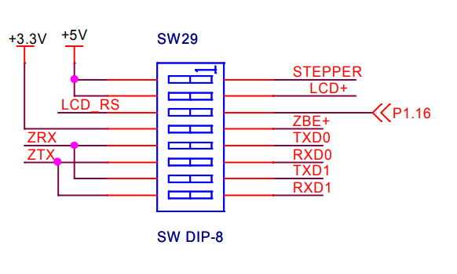
Schematic Diagram of LCD

Slide 7
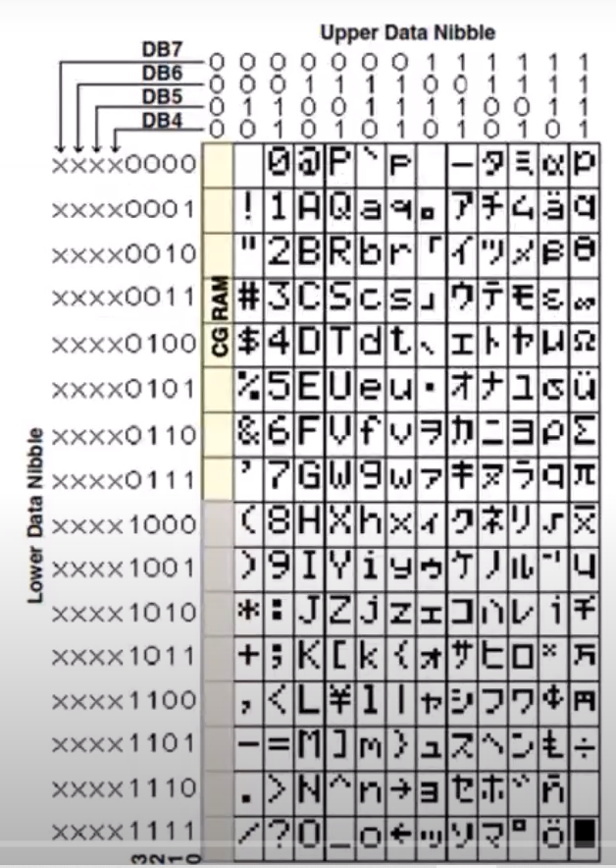
Character Display LCD
0011 0001 -X”31”
0011 0010 -X”32”

Slide 8
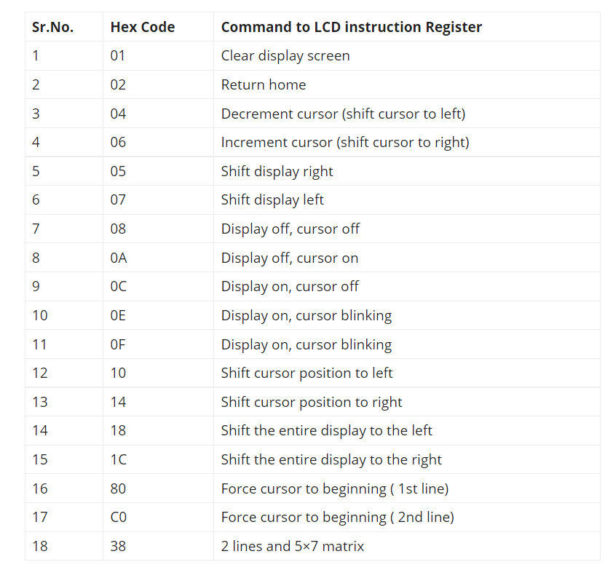
COMMAND CODES

Slide 9
Step 1-Initialize LCD
Initialization
Wait for 15ms, Power-on initialization time for LCD16x2.
Send 0x02 command which initializes LCD 16x2 in 4-bit mode.
Send 0x38 command which configures LCD in 2-line, 8-bit mode, and 5x8 dots.
Send any Display ON command (0x0E, 0x0C)
Send 0x06 command (increment cursor)

Slide 10
Header files and Declarations
#include <LPC214x.H>
#define RS 0x0010000
#define EN 0x0020000
#define D0 0x0040000
#define D1 0x0080000
#define D2 0x0100000
#define D3 0x0200000
#define D4 0x0400000
#define D5 0x0800000
#define D6 0x1000000
#define D7 0x2000000
char cmd[8] = {0x33,0x32,0x38,0x0C,0x06,0x01};
char msg[] = {" ARM7 TYRO VER4 "};
char msg1[]= {" > LCD DEMO < "};

Slide 11
LCD functions
void lcd_cmd (char);
void lcd_data (char);
void lcd_Init (void);
void lcd_display (void);
void lcd_Convert(char);
void delay(int);

Slide 12
LCD Command
void lcd_cmd(char data) // LCD Command Mode
{
IO1CLR = RS;
lcd_Convert(data);
}

Slide 13
LCD Data
void lcd_data (char data) // LCD Data Mode
{
IOSET1 = RS;
lcd_Convert(data);
}

Slide 14
Delay
void delay(int n)
{
unsigned int i,j;
for(i=0;i<n;i++)
{
for(j=0;j<12000;j++)
{;}
}
}

Slide 15
LCD DISPLAY
void lcd_display (void)
{
unsigned int i;
lcd_cmd(0x80); delay(10); // Display First Line
for(i=0;msg[i]!='\0';i++)
{
lcd_data(msg[i]); delay(40);
}
lcd_cmd(0xC0); delay(10); // Display Second Line
for(i=0;msg1[i]!='\0';i++)
{
lcd_data(msg1[i]); delay(40);
}
}

Slide 16
LCD CONVERT
void lcd_Convert(char c)
{
if(c & 0x80) IOSET1 = D7; else IOCLR1 = D7;
if(c & 0x40) IOSET1 = D6; else IOCLR1 = D6;
if(c & 0x20) IOSET1 = D5; else IOCLR1 = D5;
if(c & 0x10) IOSET1 = D4; else IOCLR1 = D4;
if(c & 0x08) IOSET1 = D3; else IOCLR1 = D3;
if(c & 0x04) IOSET1 = D2; else IOCLR1 = D2;
if(c & 0x02) IOSET1 = D1; else IOCLR1 = D1;
if(c & 0x01) IOSET1 = D0; else IOCLR1 = D0;
IOSET1 = EN;
delay(5);
IOCLR1 = EN;
}

Slide 17
LCD INIT
void lcd_Init(void) // LCD Initialize
{
unsigned int i;
for(i=0;i<6;i++)
{
lcd_cmd(cmd[i]);
delay(10);
}
}

Slide 18
Main
int main(void)
{
IO1DIR = 0x3FF0000;
lcd_Init();
while(1)
{
lcd_cmd(0x01);
lcd_display();
delay(300);
}
}

Slide 19
Thank You

